Slide 1
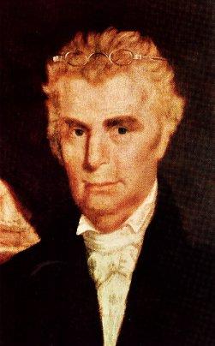
Family Life Of Barton W. Stone
Barton & Eliza Had One Son And Four Daughters Together – The Son Died Early
Eliza Campbell Stone Died In 1810
Stone Married Celia Bowen Of Gallatin, Tennessee in 1811
Moved To Gallatin In Hopes To Take Over Bowen Home And Plantation
1812 He Returns To Kentucky To Teach And Preach

Slide 2
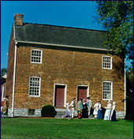
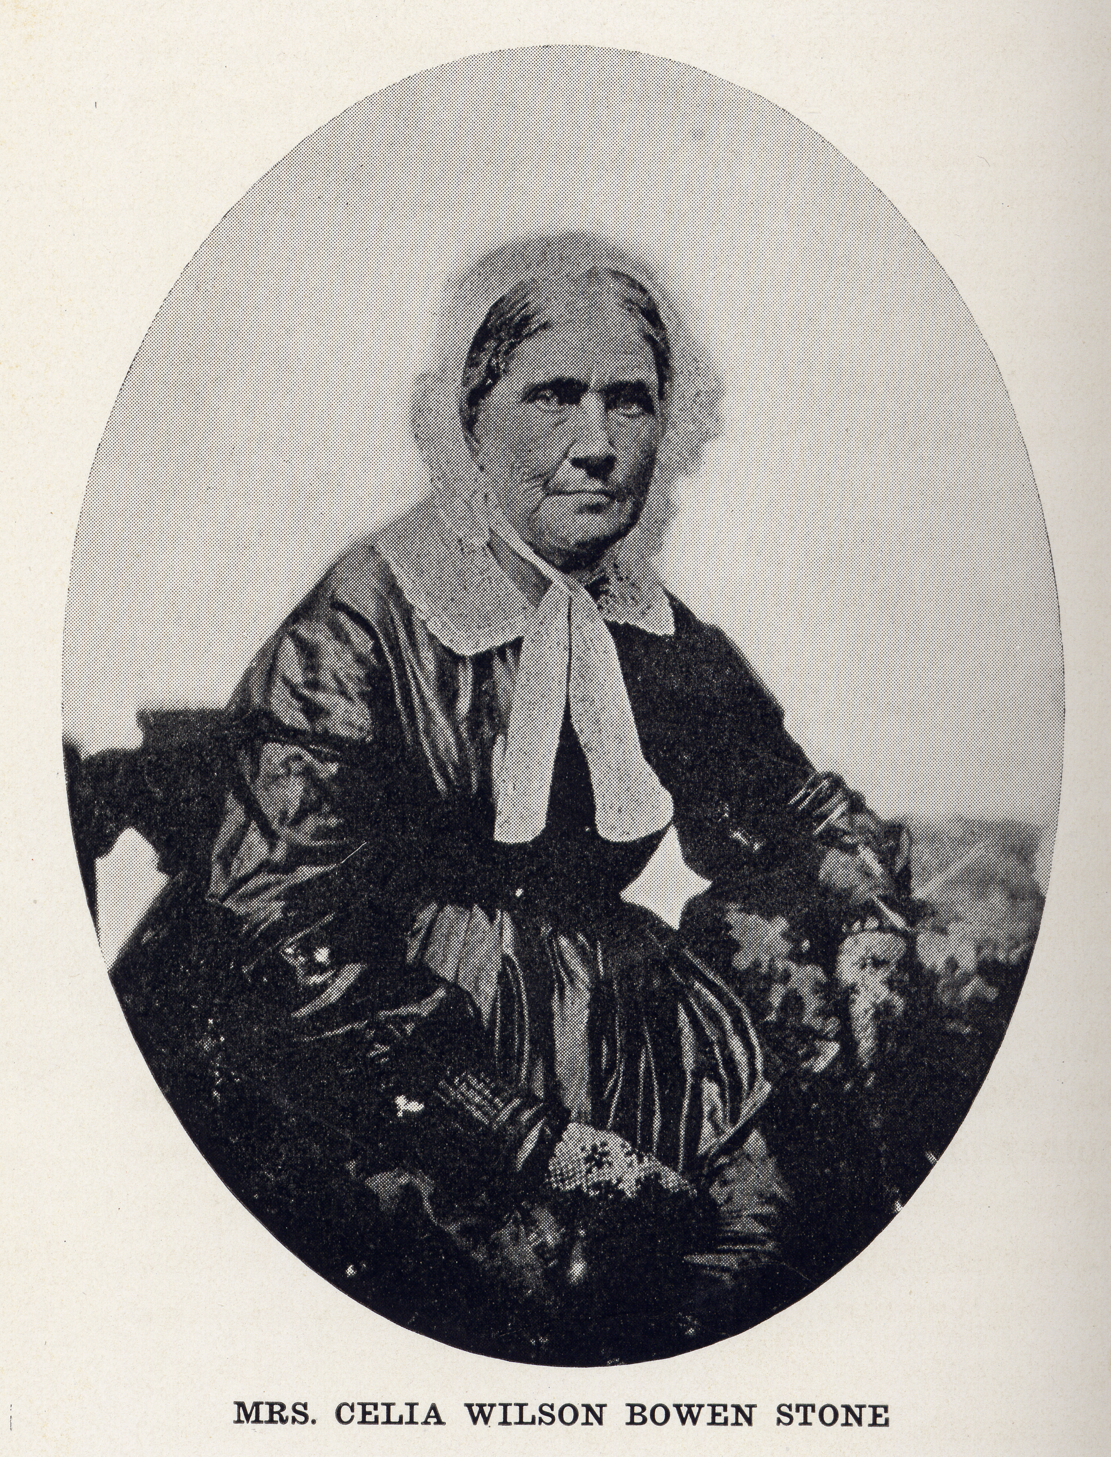
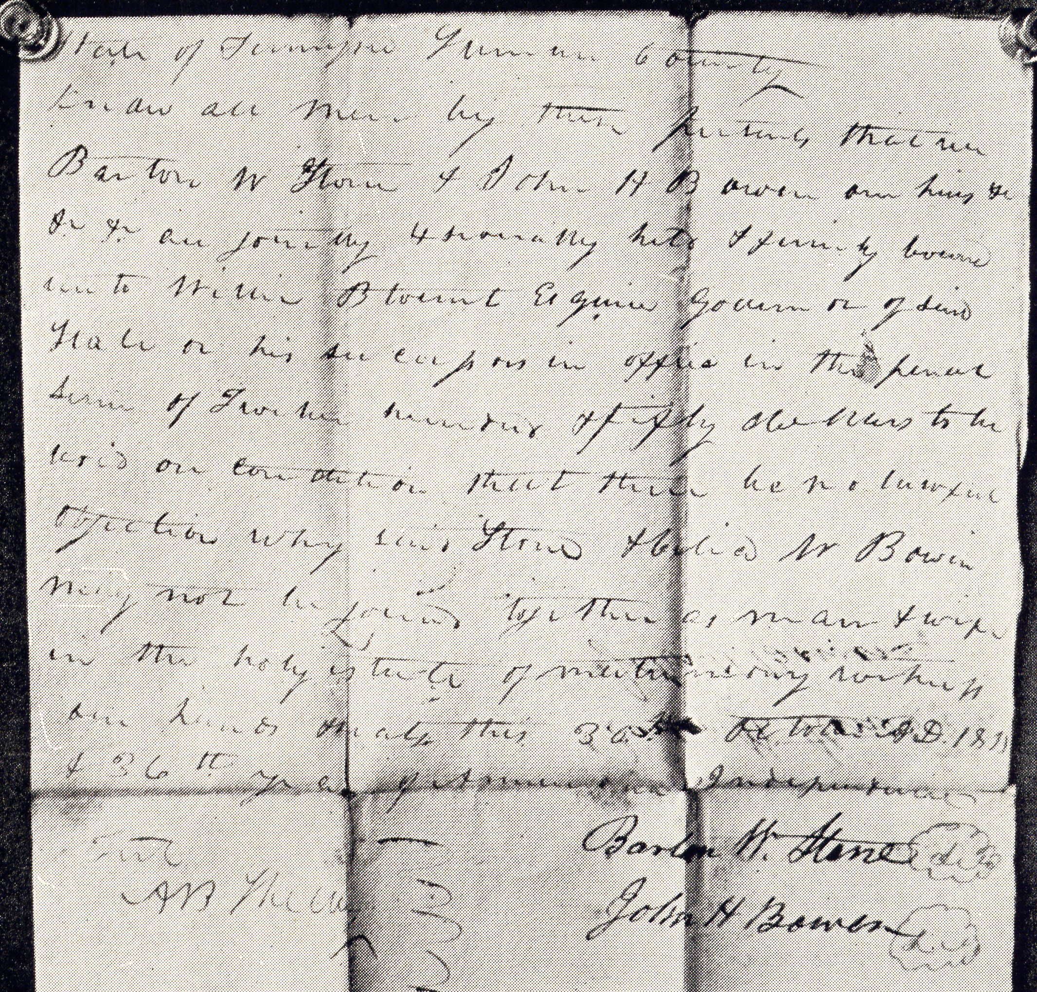
While At Gallatin, Tennessee
Married Celia Bowen October 31, 1811
Bowen Home Mansker’s Station, Tennessee
Copy Of Marriage Bond, Gallatin, Tennessee

Slide 3
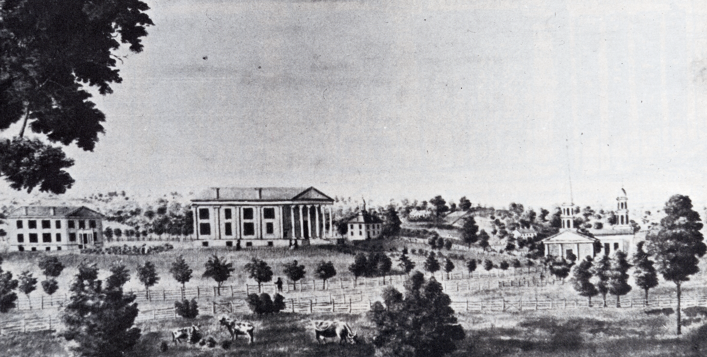
Stone At Rittenhouse Academy
1819 Stone Was Invited To Come And Be Headmaster
1819, Nov. 11 Purchase 123 acres on edge of town
Note: In 1829 It Became Absorbed Into The Georgetown College (Baptist) – Continues To This Day

Slide 4
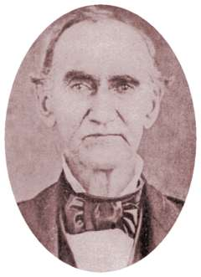
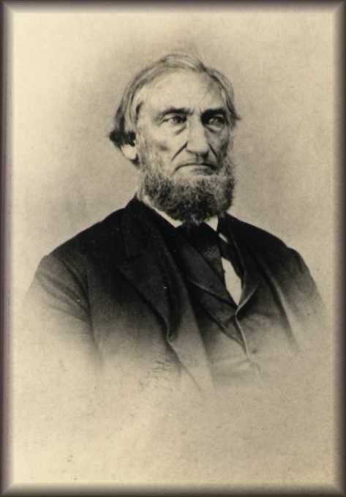
Stone’s Influence
Influence Many Greats Of The Rest. Movement
James Matthews
B.F. Hall
John T. Johnson
And Many Others
1824 Met Alexander Campbell
Produced Christian Messenger 1826-1844
John T. Johnson
B.F. Hall

Slide 5
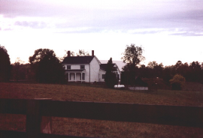
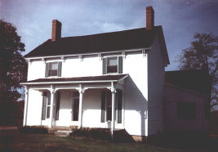
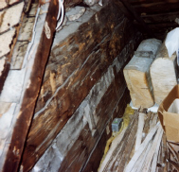
Stone House In Georgetown
In 1819 Stone Purchased A House And 123.5 Acres Of Land.
The Land Had Belonged To Israel Grant, A Nephew Of Daniel Boone.
The House Stands About A Mile East Of Town.

Slide 6
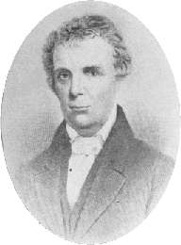
The Christian Messenger
The Christian Messenger Ran From 1826-1844
John T. Johnson Helped Produce It
Kept The Brotherhood Connected

Slide 7
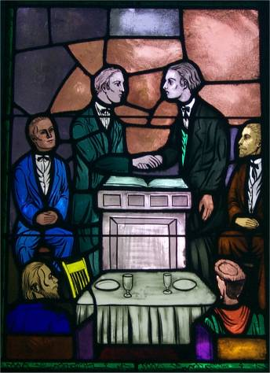
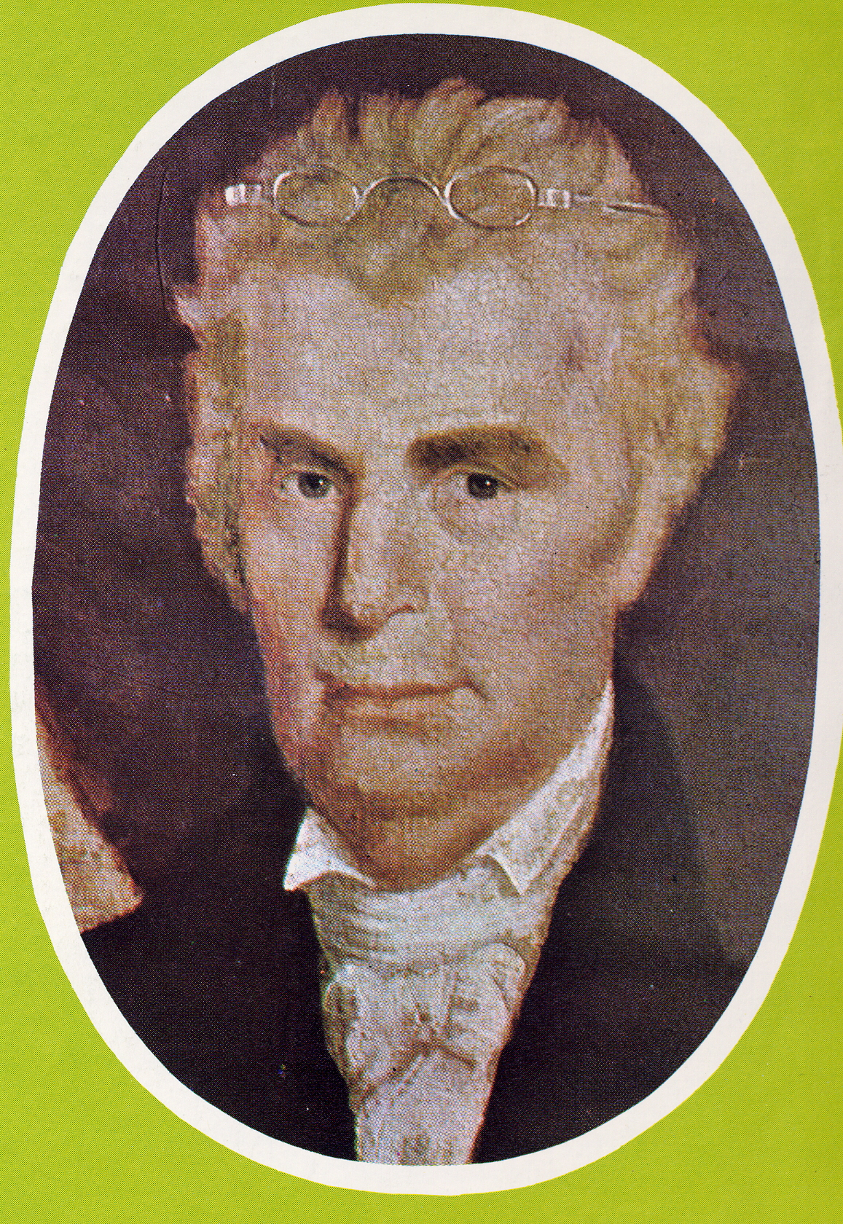
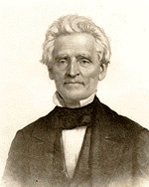
Coming Together Of A Movement
Meeting Of Stone’s Christians & Campbell’s Disciples At Hill Street Church In Lexington, Last Week In 1831
January 1, 1832 Joined Forces With A. Campbell’s Disciples Movement
“Let us, then my brethren, be no longer Campbellites or Stoneites, New Lights or Old Lights, or any other kind of lights, but let us come to the Bible, and to the Bible alone, as the only book in the world that can give us all the light we need.” — John Smith
Hill Street Church, Lexington, Kentucky
“Raccoon” John Smith

Slide 8
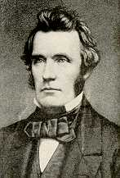
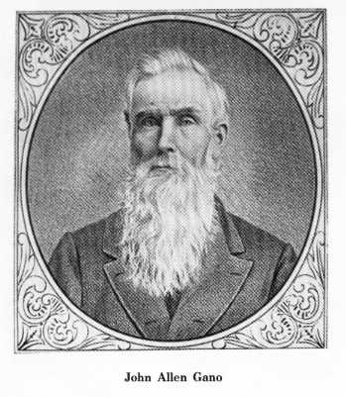
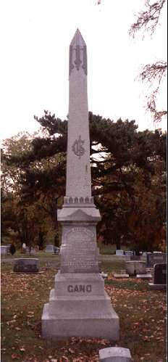
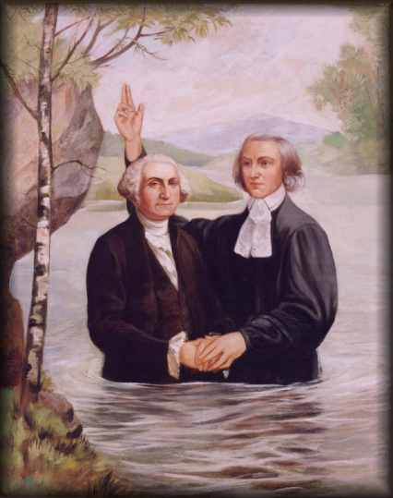
John Allen Gano 1805-1887
Noted As Baptizing More Kentuckians Than Any Other Preacher
Wealthy Land Owner In Bourbon County, Kentucky
Preached At Cane Ridge & Georgetown
Helped Underwrite The Work In Many States Esp. Missouri Through His Friendship With T.M. Allen
Claim To Fame:
His Grandfather, John Gano, Baptist Preacher Immersed George Washington In The Potomac River
One Of His Descendants Was Howard Hughes, Billionaire

Slide 9
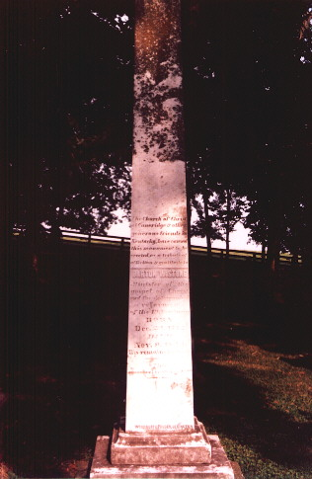
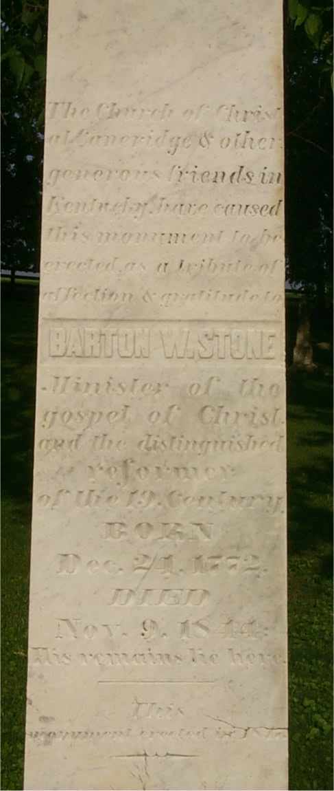
Cane Ridge Cemetery
The Church of Christ
at Caneridge & other
generous friends in Kentucky
have caused this monument
to be erected as a tribute of
affection & gratitude to
BARTON W. STONE
Minister of the gospel of
Christ and the distinguished
reformer of the 19 Century.
BORN Dec. 21, 1772
DIED Nov. 9, 1844
His remains lie here.
This monument was erected in 1847

Slide 10
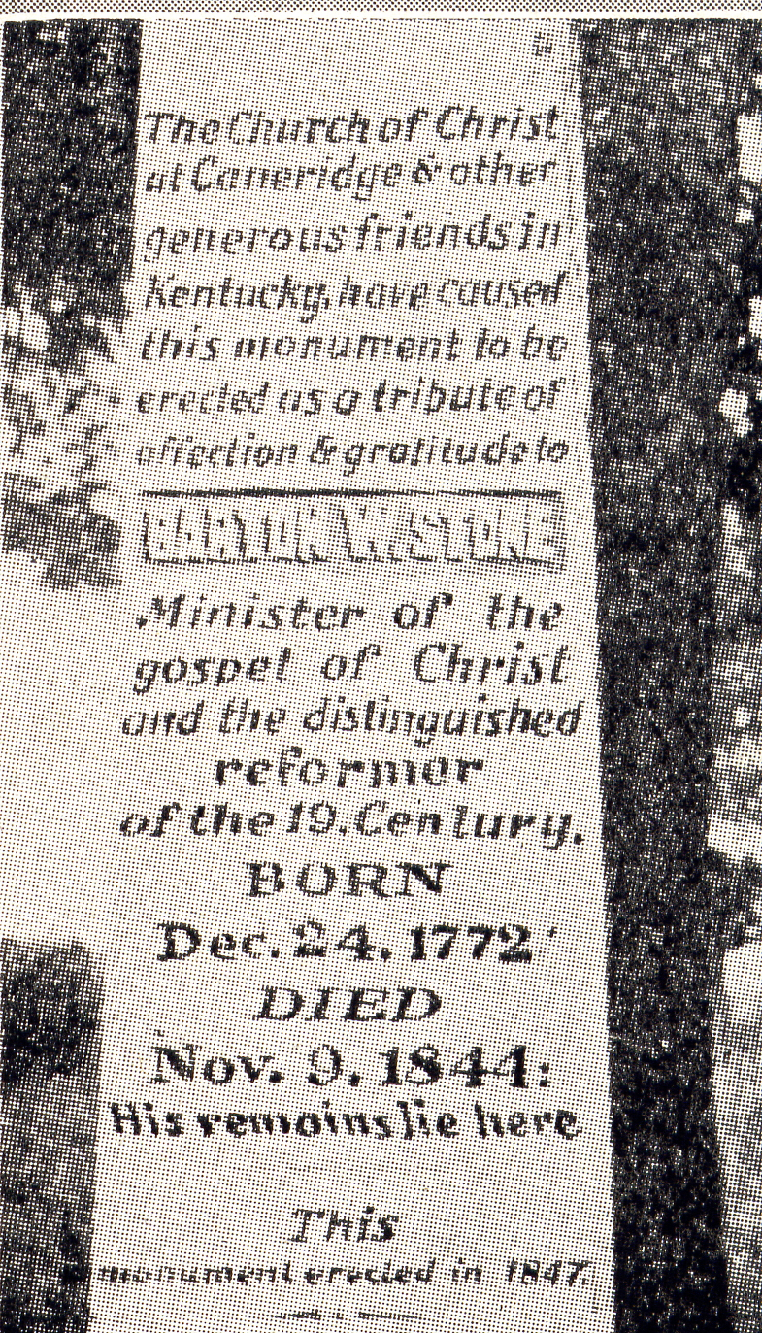
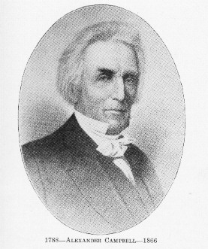
Campbell’s Visit
When The Inscription Was Being Considered As To What Was Appropriate For Stone’s Memorial, Letters Were Written To Many Requesting Suggestions, With No Response. John Rogers Wrote The Words That Appear On The Monument. When A. Campbell Visited The Grave Of His Old Friend, He Suggested That The Words “the distinguished reformer” Should More Properly Be Written As “A distinguished reformer.” Rogers Was Present And Responded, “What I Have Written, I Have Written.”

Slide 11
Grave Of William Rogers
William Rogers
BORN IN
Campbell Co. VA
July 7, 1784. Removed With His Father To Caine Ridge Bourbon Co. Apr, 1798
United With The Church Of Christ At Cane Ridge In 1807
DIED Feb. 15, 1862.
In The 78 Year Of His Age.
He was the friend of God

Slide 12
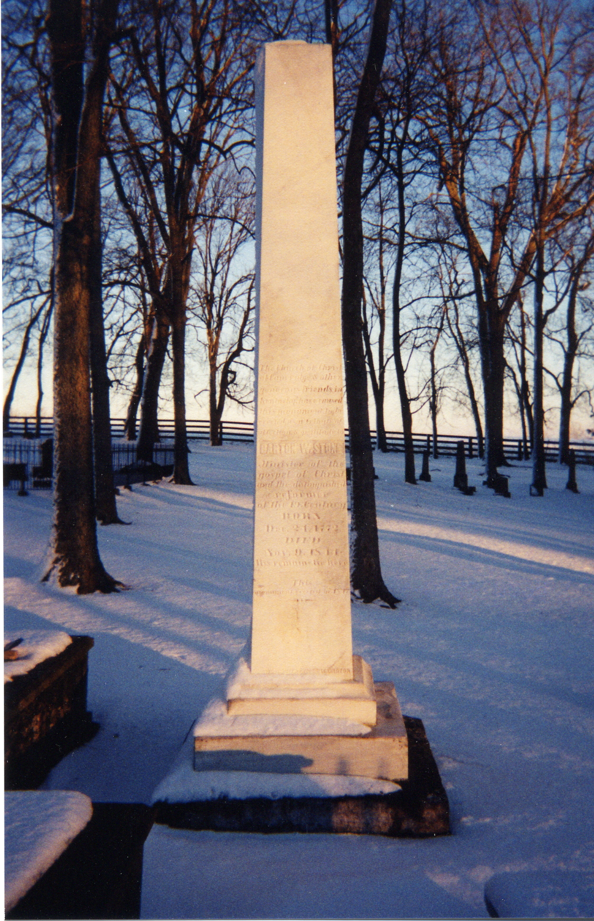
Around Cane Ridge

Slide 13
Around Cane Ridge

